Slide 1
AI Tech Team
Taumer Anabtawi, Katie Finley, Jeff Huggins

Slide 2
Fuzzy Logic

Slide 3
What Is Fuzzy Logic?
A way to determine degrees of truth in a logical sentence
While Boolean Logic is complete truth/falseness, Fuzzy Logic allows for partial truth

Slide 4
Classical Sets vs. Fuzzy Sets
apple = {...}
notApple = {...}
Classical Set:
apple1 fully participates in apple{ }, fully does not participate in notApple{ }
…
apple4 fully does not participate in apple{ }, fully participates in notApple{ }
Fuzzy Set:
apple1 participates 100% in apple{ }, 0% in notApple{ }
apple2 participates 70% in apple{ }, 30% in notApple{ }
...

Slide 5
How Fuzzy Logic Is Used
Step 1: Define Fuzzy Sets
Step 2: Define Fuzzy Rules
Step 3: Fuzzification
Step 4: Apply Fuzzy Rules
Step 5: Defuzzification
Ex: Car driving to destination
some distance

Slide 6
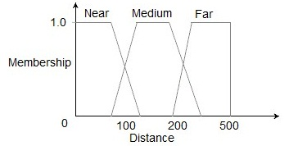
Step 1: Define Fuzzy Sets
Membership function for set A at point x is denoted μA(x) upon interval [0, 1]
Distances will be Near, Medium, and Far
30 60 100

Slide 7
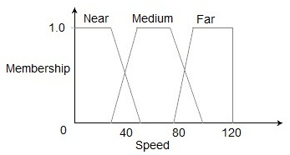
Step 1: Define Fuzzy Sets
Speeds will be Slow, Medium, and Fast
Slow Medium Fast

Slide 8
Step 2: Define Fuzzy Rules
Rule 1: If distance is Near then speed is Slow
Rule 2: If distance is Medium then speed is Medium
Rule 3: If distance is Far then speed is Fast

Slide 9
Step 3: Fuzzification
Map actual values to their membership of all sets
Ex: Distance of 22
μNear(22) = 0.9, μMedium(22) = 0.1, μFar(22) = 0

Slide 10
Step 4: Apply Fuzzy Rules
Map fuzzified input to corresponding output sets
Produces a confidence value associated with the output sets

Slide 11
Step 5: Defuzzification
Combine into a single fuzzy set based on confidence
This output fuzzy set is defuzzified for a single value (usually by centroid)
23.70

Slide 12
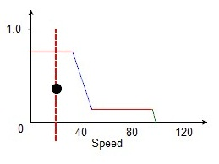
Step 5: Defuzzification

Slide 13
Other Methods
Membership functions
triangular, bell, sinusoidal, exponential
Inference mechanism
Sugeno
calculates degree of applicability immediately after defining fuzzy sets/rules
Defuzzification mechanism
bisector, mean of maximum, largest of maximum, smallest of maximum

Slide 14
Why Use Fuzzy Logic?
Flexibility
Tolerability of imprecise data
Ability to model nonlinear functions
Based on natural language
Low computation costs

Slide 15
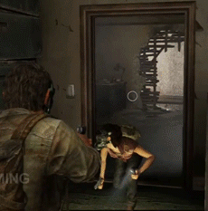
Why use Fuzzy Logic in Games?
Vast improvement in AI decision making!
Traditional decision making:
Results in unnatural sudden switches from one decision to another
Fuzzy decision making:
More natural behavior with gradual changes in behavior

Slide 16
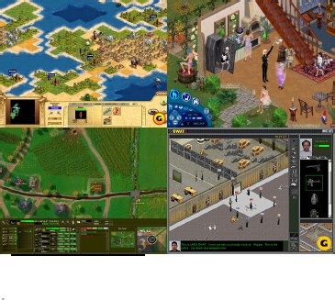
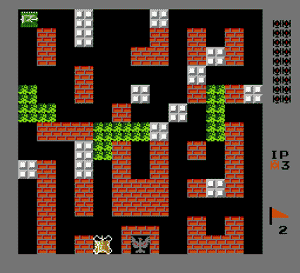
Examples of Fuzzy Logic in Video Games
Used in games where NPCs need to make decisions based on their surroundings
Examples (Pictured left to right):
Civilization: Call To Power
Personalities of leaders
The Sims
BattleCity
S.W.A.T 2
Revolutionary AI
Halo 3
Notes:
http://www.academia.edu/6850195/The_use_of_Fuzzy_Logic_for_Artificial_Intelligence_in_Games

Slide 17
Battle City - 1985 (1st Version)
Battle City
NPC Tanks strive to protect base alongside human player
Enemies exhibit random behavior
Tanks act based on three factors:
Time since last attack
Damage of walls surrounding base
Strength of enemies in sight
Used to calculate roaming radius of tanks
How far can I go from the base?
Notes:
http://www.northeastern.edu/magy/courses/AI/FuzzyLogicGames.pdf
http://image.t45ol.com/screenshot/big/8950.jpg

Slide 18
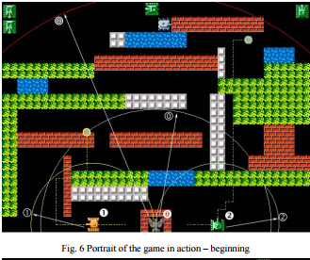
Battle City - Fuzzy Logic Implementation
Define fuzzy sets:
Time since last assault
Now, Recent, History
Shield
Poor, OK, Good
Enemy Strength
Weak, Moderate, Strong
Define fuzzy rules and defuzzify:
Calculate roaming distance

Slide 19
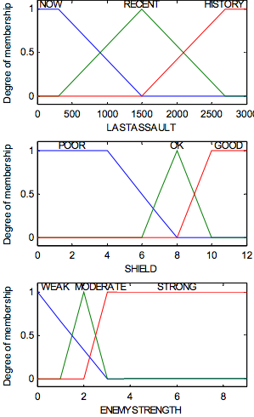
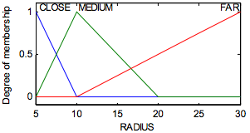
Battle City - Fuzzy Logic Implementation
Fuzzification
Notes:
http://www.northeastern.edu/magy/courses/AI/FuzzyLogicGames.pdf

Slide 20
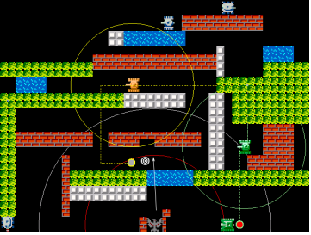
Battle City - Fuzzy Logic Implementation
Case: Base is in danger
Enemy is close, base is weak and enemy is strong
Roaming radius of protecting tanks should be low
Return To Base!
Notes:
http://www.northeastern.edu/magy/courses/AI/FuzzyLogicGames.pdf

Slide 21
Battle City - Results
Pros:
Teammate tank makes “smart” decisions
Takes into account many factors before acting
More strategical and challenging experience for user
Easy to implement
Computationally light
All factors considered at once
Cons:
Might be “overkill”
Enemy movement is purely random
AI can be too smart
Human players can become frustrated

Slide 22
Pac Man (Non Official)
Non-Official version of Pac Man with intelligent ghosts
Ghost decision making based on a fuzzy logic implementation
Possible ghost behavior:
Hunter
Actively go after Pac Man
A* search
Defense
Run to areas with many pellets
Lure Pac Man
Shy
Ghosts run away from other ghosts
Enemies are spread out
Random
Default Case
Notes:
http://ccis2k.org/iajit/PDF/vol.3,no.4/7-Adnan.pdf
http://www.creightonevans.com/images/Fuzzy%20Pac-Man.jpg

Slide 23
Choosing Ghost Behavior
Set of Fuzzy Rules decide which behavior is chosen
Factors Considered:
Relative Pac Man location
Relative Ghost Location
Pellet number remaining
Player Skill
Calculated from a separate set of fuzzy rules
Derived from:
Pellet consumption rate
Length of time player has been alive
Likelihood of behavior being exhibited calculated from result of Fuzzy Logic calculation
Notes:
http://ccis2k.org/iajit/PDF/vol.3,no.4/7-Adnan.pdf

Slide 24
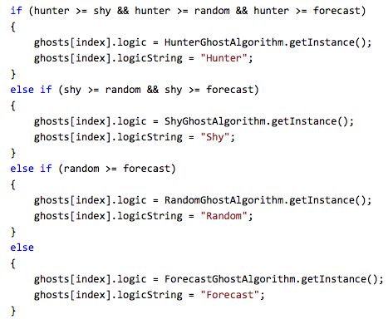
Fuzzy Logic Pac Man: A Code Example
Confidence value calculated based on pre-chosen factors
Decide which behavior to exhibit based on output of fuzzy logic calculation
Notes:
https://thepacman.codeplex.com/SourceControl/latest#Pacman/FuzzyController.cs

Slide 25
Fuzzy Logic Pac Man: A Code Example
Calculate Hunter behavior likelihood from the pre-chosen factors
Distance, Skill, Pellet amount
Notes:
https://thepacman.codeplex.com/SourceControl/latest#Pacman/FuzzyController.cs

Slide 26
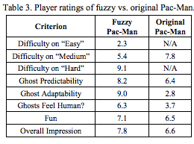
Fuzzy Logic Pac Man: Results
Players surveyed to assess implementation of game
Users saw the game as :
Less predictable
More “human” like
More fun
Better overall
Conclusion: Better overall game without sacrificing simplicity and performance

Slide 27
Artificial Neural Networks

Slide 28
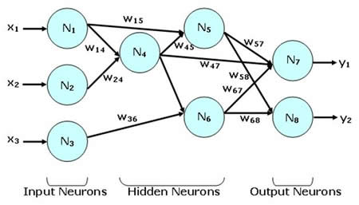
What is an artificial neural network?
Think of a system of connected “neurons” that exchange information with each other
The connections have numeric weights that can be adjusted based on experience
This allows the network to be capable of “learning”
Best used when trying to approximate or estimate an output
Pattern Recognition
Example: Handwriting recognition software
Notes:
https://en.wikipedia.org/wiki/Artificial_neural_network#Learning_algorithm

Slide 29
How does the network learn?
Weights are determined by training - most commonly is through back-propagation
For a given input, compare actual output to desired output
Working backwards from the output neuron, adjust the weights of the inter-neuron connections
Use a training set
Submit training set as input to the network
Calculate the error for the output neurons
Back-propagate the error across the hidden neurons
Adjust weights

Slide 30
Neural Network Example
Input
Hidden
Output
m1
m6
m2
m7
m3
m8
m4
m5

Slide 31
Neural Network Example - Submit training set
Input
Hidden
Output
f3(x)
m1
m6
x1
f1(x)
m2
f4(x)
m7
m3
f6(x)
x2
f2(x)
m8
m4
m5
f5(x)
f3(x) = y1 * m1
f4(x) = y1 * m2 + y2 * m4
f5(x) = y1 * m3 + y2 * m5
f6(x) = y3 * m6 + y4* m7 + y5 * m8

Slide 32
Neural Network Example - Calculate Error
Input
Hidden
Output
f3(x)
m1
m6
x1
f1(x)
m2
m7
Error = Actual Output -
Desired output
m3
f4(x)
f6(x)
x2
f2(x)
m8
m4
m5
f5(x)

Slide 33
Neural Network Example - Back-Propagate Error
Input
Hidden
Output
f3(x)
m1
m6
x1
f1(x)
m2
f4(x)
m7
m3
f6(x)
x2
f2(x)
m8
m4
m5
f5(x)
No error on input neurons
Error6 = Actual Output -
Desired output
Error3 = Error6 * m6
Error4 = Error6 * m7
Error5 = Error6 * m8

Slide 34
Neural Network Example - Adjust weights
Input
Hidden
Output
f3(x)
m1
m6
x1
f1(x)
m2
f4(x)
m7
m3
f6(x)
x2
f2(x)
m8
m4
m5
f5(x)
c = Learning Rate
m1’ = m1 + c*Error3*f3’(y1)
m2’ = m2 + c*Error4*f4’(y1)
m3’ = m3 + c*Error5*f5’(y1)
m4’ = m4 + c*Error4*f4’(y2)
m5’ = m5 + c*Error5*f5’(y2)
m6’ = m6 + c*Error6*f6’(y3)
m7’ = m7 + c*Error6*f6’(y4)
m8’ = m8 + c*Error6*f6’(y5)

Slide 35
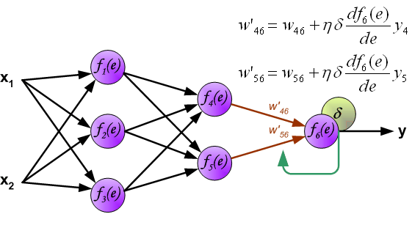
More on Back-Propagation

Slide 36
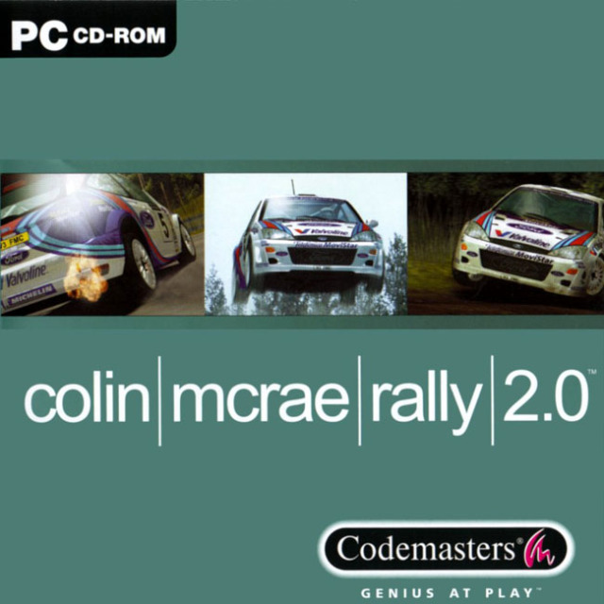
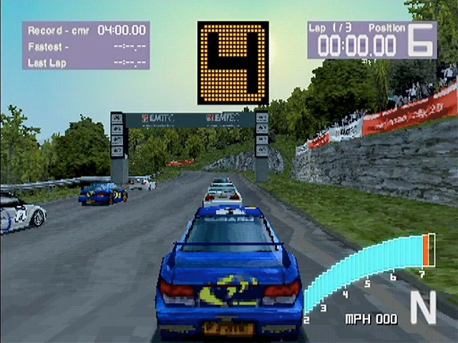
Artificial Neural Networks in video games
Colin McRae Rally 2.0 (PlayStation)
Same creators as the Dirt racing series.
AI opponents were modeled after how the developers handled their cars (going in and out of turns, accelerating, braking, driving on different surfaces, etc.)
Key to its success was determining the necessary input variables to monitor
Weights can be adjusted to give different “personalities” to the drivers
Notes:
http://www.generation5.org/content/2001/hannan.asp

Slide 37
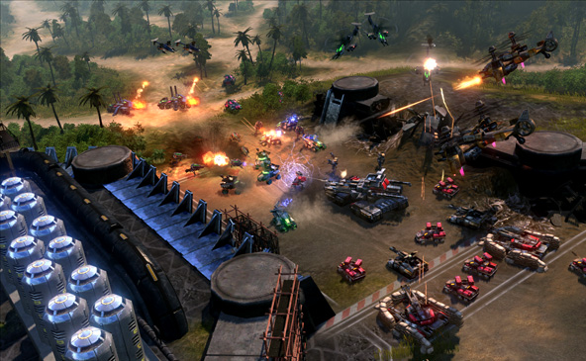
Other Opportunities to Use ANNs in Games
Threat Assessment
Enemy AI in an RTS
Inputs: Number of player ground units, number of player aerial units, an indication whether either is on the move, and the range to the ground or aerial units.
Outputs: Ground threat, aerial threat, ground and aerial threat, no threat
Attack or Flee
Enemy AI in an RPG
Many possible inputs: number of similar enemies within a near proximity (alone or in a group), health remaining, presently engaged in combat, range to the player
Could also take into account whether unit is a ranged or melee type attacker
Outputs: Attack, find cover, flee
Notes:
http://www.onlamp.com/pub/a/onlamp/2004/09/30/AIforGameDev.html

Slide 38
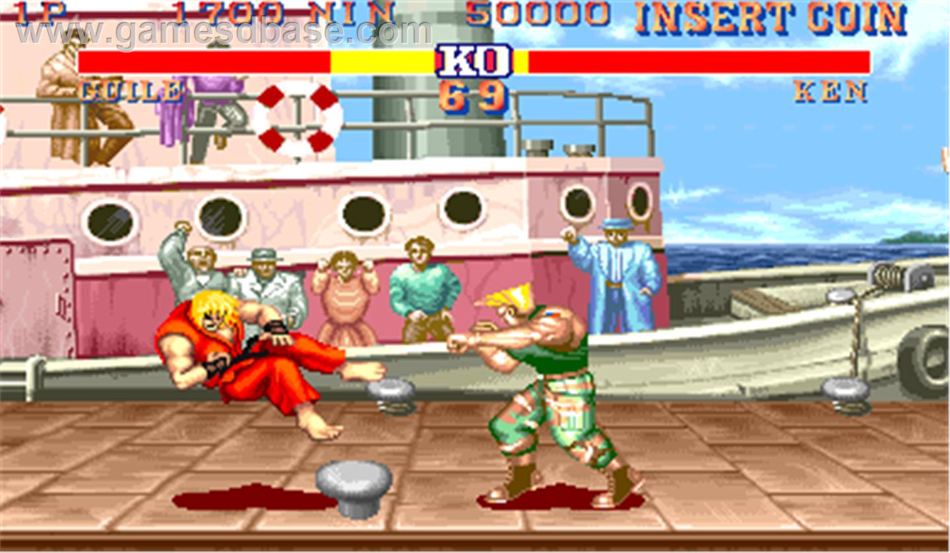
Other Opportunities to Use ANNs in Games (cont.)
Anticipating the player’s next move
Enemy AI in fighting games
Example: 3 possible attacks from player
Inputs: Player’s last 3 attacks
After many training sets, the AI would be able to predict the odds of a player’s next move based on the combination of his past 3 moves
Output: Likely next attack

Slide 39
ANFIS: Adaptive Neuro Fuzzy Inference System

Slide 40
What is ANFIS?
Developed in the early 1990s
Inference system that combines neural networks and fuzzy logic
Allows users to use both systems in a single framework
Fuzzy rules with learning capability
Membership function parameters change as system learns
Can be calculated using back propagation
Can employ a genetic algorithm
Fitness helps choose parameters
Notes:
https://en.wikipedia.org/wiki/Adaptive_neuro_fuzzy_inference_system
http://www.mathworks.com/help/fuzzy/neuro-adaptive-learning-and-anfis.html

Slide 41
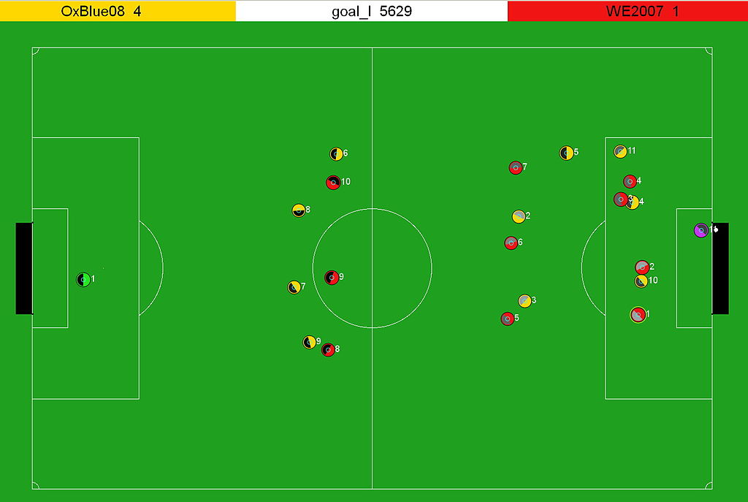
Robocup Simulation
Soccer simulation league
Agents perform using AI
ANFIS implementation
Used to calculate player position
Notes:
http://www.cs.cmu.edu/~guyang/Everest/doc/FPSA.PDF
https://en.wikipedia.org/wiki/RoboCup_Simulation_League#/media/File:RoboCup-2D-Soccer-Simulation-Field.jpg

Slide 42
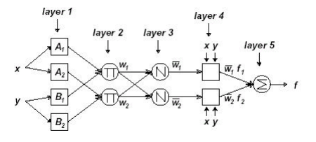
Robocup: ANFIS Implementation
Output Position
Calculate fuzzy parameters based on previous layers’ output
Map position input (ball and player) to membership function
Calculate likelihood of behavior
Notes:
http://www.cs.cmu.edu/~guyang/Everest/doc/FPSA.PDF
https://en.wikipedia.org/wiki/RoboCup_Simulation_League#/media/File:RoboCup-2D-Soccer-Simulation-Field.jpg
basically feed in, calculate based on what you know, re calc and output

Slide 43
Sources
Short fuzzy logic tutorial:
http://cs.bilkent.edu.tr/~zeynep/files/short_fuzzy_logic_tutorial.pdf
http://citeseerx.ist.psu.edu/viewdoc/download?rep=rep1&type=pdf&doi=10.1.1.125.2096
http://purvag.com/blog/?p=284
http://www.maplesoft.com/applications/view.aspx?SID=1409&view=html
http://www.mathworks.com/help/fuzzy/what-is-fuzzy-logic.html?refresh=true
http://www.mathworks.com/help/fuzzy/an-introductory-example-fuzzy-versus-nonfuzzy-logic.html
http://access.feld.cvut.cz/view.php?cisloclanku=2012080002
http://www.cs.princeton.edu/courses/archive/fall07/cos436/HIDDEN/Knapp/fuzzy004.htm
Fuzzy Logic Controllers:
http://www.ieejournal.com/Vol_5_No_6/Advanced%20Controllers%20Using%20Fuzzy%20Logic%20Controller%20(FLC)%20for%20Performance%20Improvement.pdf

Slide 44
Sources (cont.)
The Pacman Source Code:
https://thepacman.codeplex.com/SourceControl/latest
Fuzzy Logic in Games:
http://www.academia.edu/6850195/The_use_of_Fuzzy_Logic_for_Artificial_Intelligence_in_Games
Helpful Videos
Pretty good explanation of fuzzy logic with examples:
https://www.youtube.com/watch?v=r804UF8Ia4c
Neuro-Fuzzy Modeling and Control:
http://ieeexplore.ieee.org/stamp/stamp.jsp?tp=&arnumber=364486

Slide 45
Questions?

